Slide 1
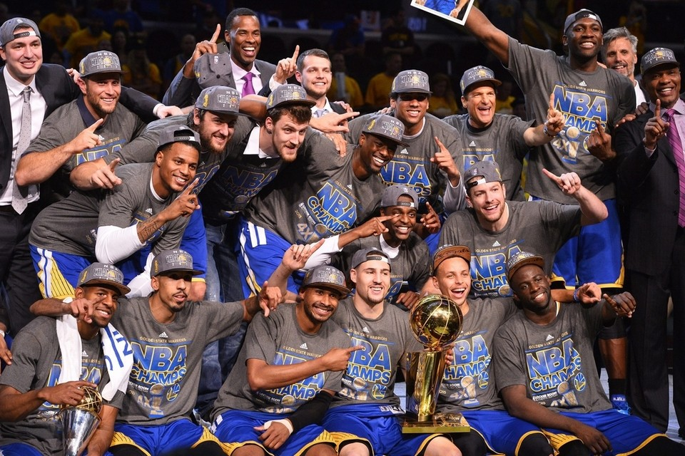
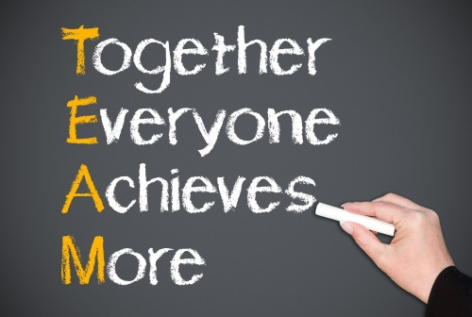
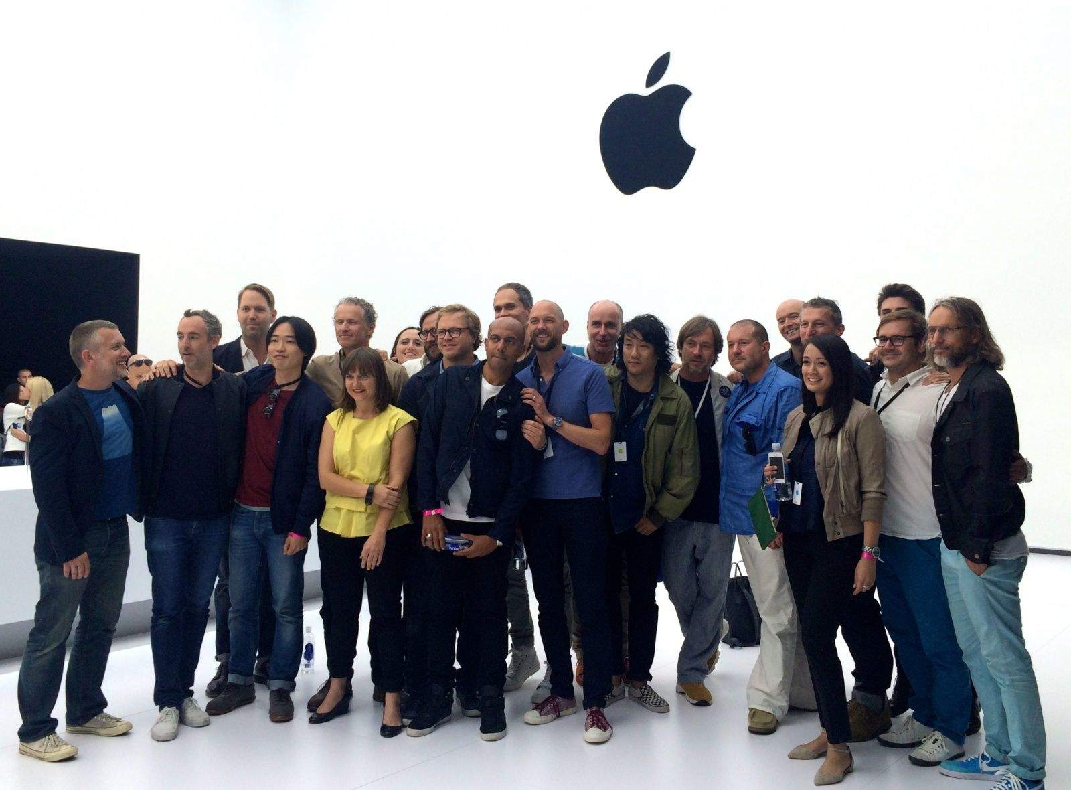
What makes a team successful?
Think Businesses, sports teams, movie productions, and music companies
On a piece of paper and write down as many characteristics to the question above

Slide 2
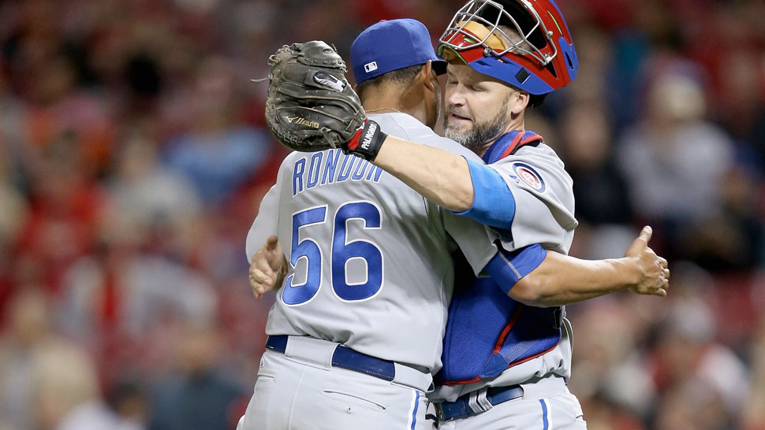
Today we will: learn what makes a great teammate
So we can: apply these characteristics to our future teams

Slide 3
True Colors Test

Slide 4
The Results
A, H, K, N, S = ORANGE
B, G, I, M, T = GOLD
C, F, J, O, R = BLUE
D, E, L, P, Q = GREEN
Notes:
4
Break into COLOR GROUPS and discuss what you feel your faculty needs to know about your color. When you work and are in your groups, what does your color look like? Who is this person? How does the color contribute? What kinds of things will support this color person and bring this person down? What are your commonalities? Report out?

Slide 5
BLUE

Slide 6
BLUE Being involved with people is very important to you!
Like to take care of others
Optimistic
Passionate
Enthusiastic
Imaginative
Work hard for a cause
Peacemaker
Need to be unique
Cooperative rather than competitive
Strong sense of spirituality
People oriented
Notes:
6

Slide 7
Blue Strengths
Leading
Listening
Mentoring
Motivating
Optimism
Recruiting
Speaking
Supportiveness
Teaching
Tolerance
Accepting
Getting things started
Communicating
Cooperating
Counseling
Creating
Guiding
Imagination
Have a “hunch”
Notes:
7

Slide 8
Communicating with the Blue
When Blues listen, they focus on more than words.
Need to form a relationship with a Blue first for them to hear your message.
Blues don’t want to let anyone down, so they have a difficult time saying “no”.
Blues may portray the opposite of what they are feeling.
Blues want you to be sincere when you are talking to them.
Blues are saying right now, “This is so cool! I love how this will help me relate to other people!”
Notes:
8
More discussion here as this is very important in regards to collaboration.

Slide 9
The World vs. Blue
Creating STRESS for Blues…
Broken promises
Too much negative criticism
Having tricks played on them
Not discussing what is occurring
Having to watch the clock
Conflict
Not being recognized for their own talents
Not being able to express themselves
Succeeding with the Blues…
Spend quality time one-on-one with them
Be aware that they wear their heart on their sleeve
Listen to them as they listen to you
Be supportive
Share your thoughts and feelings
Praise their creativity
Notes:
9
More emphasis here!

Slide 10
GOLD

Slide 11
Good as Gold
Prepared
Loves to plan
Detail-oriented
Punctual
Strong sense of duty
Belief in rules
Values traditions
Conscientious
Well-organized
Most comfortable with a structured environment
Notes:
11

Slide 12
Gold Strengths
Belonging
Caretaking
Collecting data
Contributing
Coordinating
Delegating
Family
Following directions
Paying attention to detail
Organizing
Planning ahead
Supervising
Notes:
12

Slide 13
Communicating with Golds
Golds can come across as businesslike.
In conversation, they want structure.
“Can we do it the way we have always done it?”
Golds listen for details.
Golds are thinking right now, “Slow down! I am still writing notes on Blues!”
Notes:
13
A bit more information here for faculty.

Slide 14
The World vs. Gold
Creating stress for Golds…
Incomplete answers or unclear tasks
Disorganization
Too many things going on at one time
Waste
People not agreeing
Changing details
Lack of structure/direction
Succeeding with Golds…
Remember to be on time
Try to be efficient and organized
They are generous but like things to be returned
Do what you say you will do
Be dependable and loyal
Respect their need to feel safe
Notes:
14
More discussion opportunities on this page.

Slide 15
ORANGE

Slide 16
Just do it! ORANGE
Extroverted Orange:
Tigger (everyone knows when he is around and very little stresses him out)
Introverted Orange:
Winnie the Pooh (goes with the flow and only major concern is HONEY!)
Notes:
16
Explain the difference between the extroverted personality and the introverted personality.

Slide 17
OUTRAGEOUS ORANGE
Energetic
Desires change
Playful
Likes to navigate
Natural entertainer
Pushes boundaries
Accepts challenges
Impulsive
Spontaneous
“Just do it!”
Appreciates immediate feedback
Most productive in non-structure environments
Notes:
17

Slide 18
Orange Strengths
Able to take charge
Carefree
Deals well with chaos
Determination
Direct communicator
Doing many things at once
Always changing
Goes with the flow
Hands-on
Keeping options open
Negotiating
Capable
Receptive to opportunities
Risk-taking
Trouble-shooting
Welcomes new ideas
Notes:
18

Slide 19
Communicating with Oranges
Oranges are confident, loud, and casual
“Now” oriented
Oranges listen for entertainment, usefulness, and relevance
They are constantly looking for opportunities
They want direct communication
Give information to an Orange in pieces
Give Oranges choices and ask for their suggestions
Notes:
19
Again, more emphasis is needed on this page.

Slide 20
The World vs. Orange
Creating Stress for Oranges…
Too much responsibility
Things being repeated
Deadlines
Rules and regulations
Being stuck at a desk
“how to” directions
Too much attention to product and not enough to performance/results
Abstract concepts
Succeeding with the Orange…
Be active and don’t slow them down!
Be spontaneous and fun
Compete in fun when appropriate
Be adventuresome and optimistic
Be energetic and ready to go!
Notes:
20
More discussion!

Slide 21
GREEN

Slide 22
Feelin’ Green
Problem-solver
“Why” mentality
Standard-setter
Cool, calm, collected
Approaches relationships logically
Likes to analyze things
Likes to think
Work is play and play is work
Need for private time
Driven by the need to feel smart
Needs things to be perfect
Notes:
22

Slide 23
Green Strengths
Analyzing
Confidence
Designing
Determination
Developing
Diagnosing
Inventing
Planning
Problem solving
Reasoning
Researching
Technical know-how
Thinking
Notes:
23

Slide 24
Communicating with Greens
Greens communicate for the purpose of gaining or sharing information.
Their favorite line is, “And your point is?”
Greens listen for information and want to know the purpose
Greens usually don’t show how they feel.
When talking to a Green, be prepared to defend your position!
Greens are thinking now,
“How will this help me with people, again?
I don’t need help with people. Why would I?”
Notes:
24
Example of “punch line” card with a BLUE person.

Slide 25
The World vs. Greens
Creating stress for Greens…
Not being in charge
Not being able to do things on their own
Lack of skill
People who show their feelings
Lack of options
Not being able to show what they know
Small talk
Routine
Being around lots of people
Succeeding with Greens…
Be aware of their curiosity about life
Give things that challenge their problem-solving abilities
Respect their need to do things on their own
Know that they are caring even though they may not show their feelings much
Respect their ideas
Notes:
25
Green father stories!

Slide 26
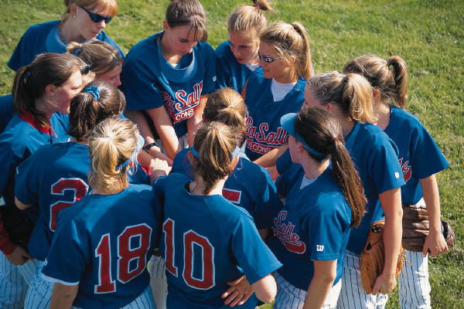
Why True Colors?
“Color” watching will help us better understand each other
Understanding each other’s “color” will help us better work together
It helps you understand the values, needs, and actions of others.
Learning the True Color language helps us to respect one another. It helps us to build relationships with others and work as a team.
Notes:
26

