Slide 1
What is a Thank You Letter?
A letter written to show appreciation for their time and interview

Slide 2
What is the purpose of a thank you letter?
The company typically asks for nothing in return, but receiving a well written thank you letter from an applicant is always special and lets the company know that the interview was greatly appreciated.

Slide 3
Heading of the letter:
The heading of a thank you letter looks like this:
Jane Doe
1245 School Lane
Oxford, Iowa 51122
(563) 555-5123 Phone
DoeJane@gmail.com Email
Yours looks like:
Name: ________________________________
Address:______________________________
City, State, Zip:__________________________
Phone:_______________________________
Email: ________________________________

Slide 4
Who do I Address the letter to?
The name of the person who interviewed you
Typically: Store Manager
What information do I include?
Dear Mr/ Ms. First Last Name or Dear Mr/ Ms. Last Name

Slide 5
What info do I include in the 1st paragraph?
-Thank the employer for the interview
-Re-state the company & position you interviewed for
- Show appreciation

Slide 6
What info do I include in the 2nd paragraph?
-Remind the employer why YOU are the best option
-Use an example of an experience to show how your skills will benefit the company
-Include your best skill/characteristic/qualification
*This makes YOU stand out from the rest of the crowd

Slide 7
What info do I include in the last paragraph?
-Express your interest one more time, without repeating yourself
-List your contact information
-Thank the employer

Slide 8
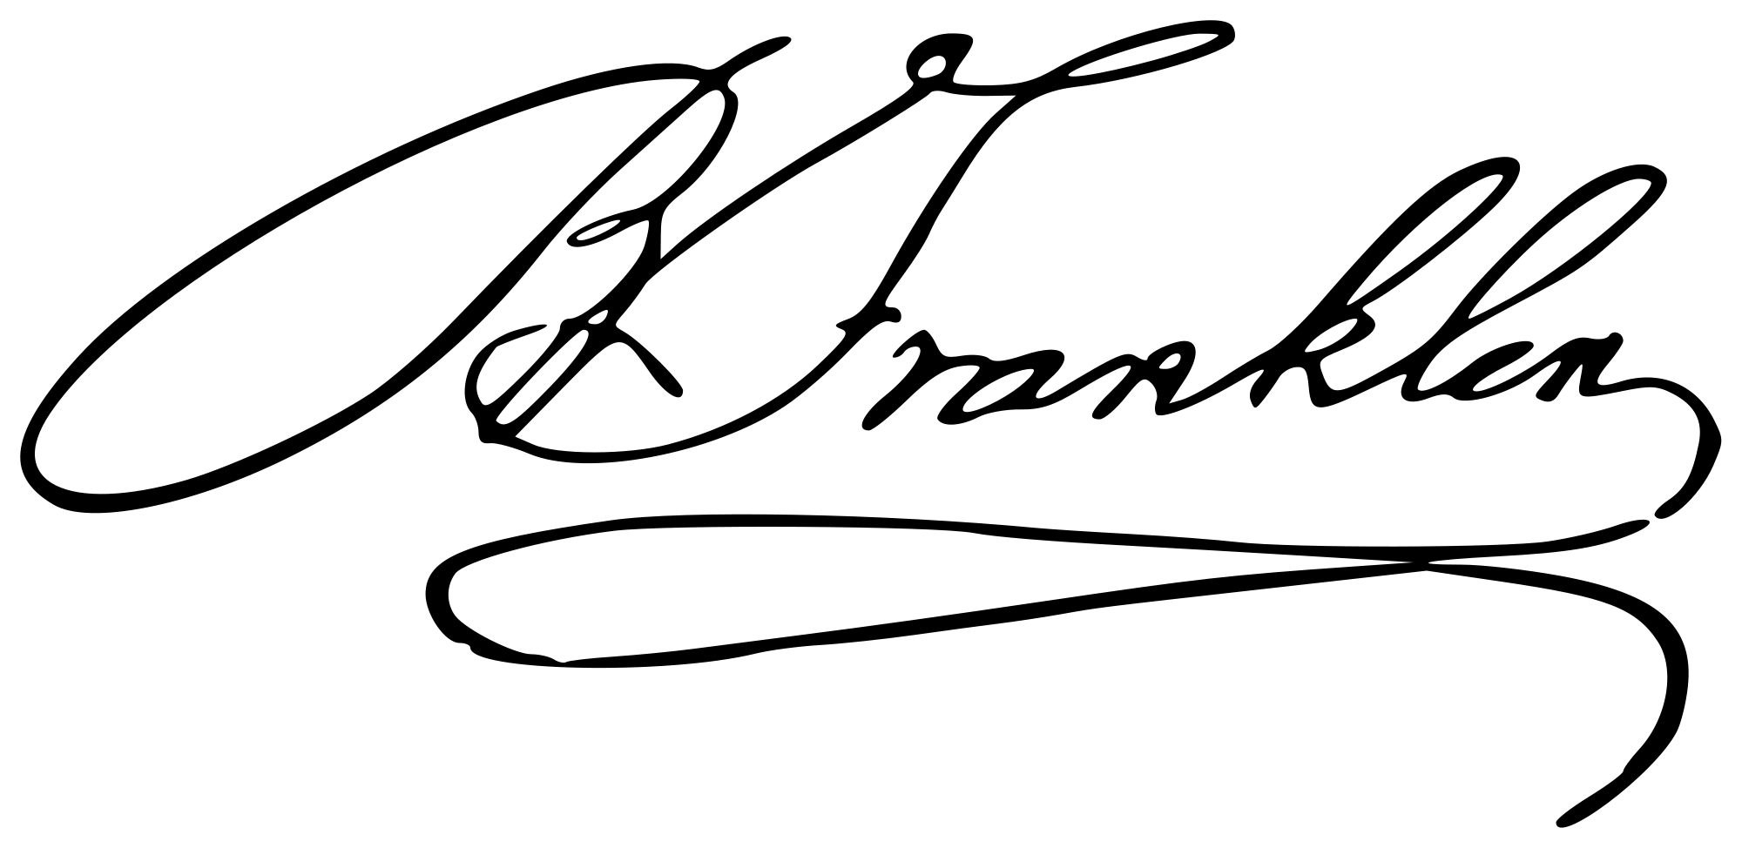
How do I end a Thank You letter?
Sincerely, Example:
(SIGNATURE HERE) Sincerely,
TYPED NAME HERE
Ben Franklin

