Slide 1
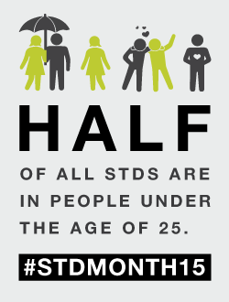
STD Facts

Slide 2
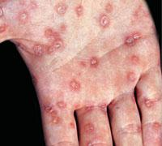
Syphilis
US
2010: 45,844 cases
2014: 63,450 cases
Iowa
2010: 68 cases
2014: 239 cases
Curable with antibiotics
Bacteria
“great imitator” -- symptoms like many other illnesses
Primary: Sores
Secondary: Rashes, Sores in mouth
Late Stages (if untreated): difficulty coordinating muscles, paralysis
Cause complications with pregnancy

Slide 3
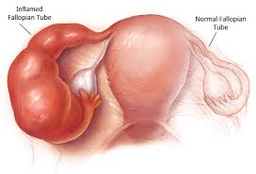
Chlamydia
Iowa
2014: 11,000 cases
US
2014: 1,441,789
Bacteria
Curable
Most people have not symptoms (75% of women don’t; 50% of men don’t)
Men: discharge from penis, burning sensation when urinating, pain and swelling one or both testicles
Women: abnormal vaginal discharge, burning during urinating
Long Term: complications with fertilization, PID

Slide 4
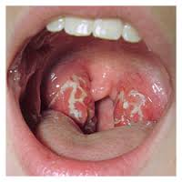
Gonorrhea
Untreated can lead to: -PID (pelvic inflammatory disease)
-Swollen fallopian tubes
-Ectopic pregnancy
-Infertility
Curable (w/ antibiotics)
Bacteria
Women: Painful/ burning urination, increased, increased vaginal discharge, vaginal bleeding between periods
Men: Painful/burning urination, discharge from penis, swollen testicles
-Can pass to baby during delivery
-Treatment cannot reverse any previous damage
More than 3 million estimated in US each year
2014
Iowa: 1,641
US: 350,062

Slide 5
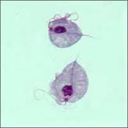
Trichomoniasis
Curable with antibiotics
Protozoa / Parasite
Men: itching, inflammation, or irritation inside the penis, burning after urination or ejaculation, or some discharge from penis
Woman: itching, inflammation, burning, redness or soreness of the genitals, unusual discharge
Baby- increases chance of premature birth & low birth weight which can cause health problems
70% of infected people DO NOT show symptoms

Slide 6
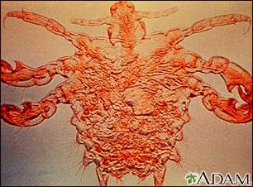
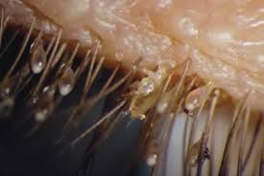
Pubic Lice………… (aka- Crabs)
Small parasite that lays eggs (nits) on hair follicle & feeds on blood
Signs: itching, red dots (bites), visually see crawling/eggs
Curable: medication cream, wash all clothing, bedding towels, & spray non-washable items with medicated spray
Spreads through skin-to-skin contact, less common- sheets, towels, clothing
Shaving does not cure pubic lice.
Lice can live anywhere there is coarse hair: eye lashes, eye brows, moustache, beard, armpits, leg hair (male), pubic hair

Slide 7
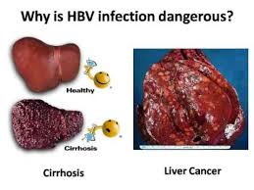
Hepatitis B
Hepatitis C
Can live outside the body for 7 days
Spread: via blood, semen, body fluid through sexual contact, sharing needles, baby at birth
Spread: via blood, sharing needles, baby at birth (Rare- sexual activity)
Infants: 90% turn chronic
1-5 yr: 50% turn chronic
Adults: 95% recover
BOTH B & C
Acute/ short term illness, or chronic / long term
Signs/Symptoms: fever, fatigue, loss of appetite, nausea, vomit, abdominal pain, dark urine, joint pain, jaundice
Long term- cirrhosis, liver disease, liver cancer
IF symptoms develop: takes 2-24 weeks

Slide 8
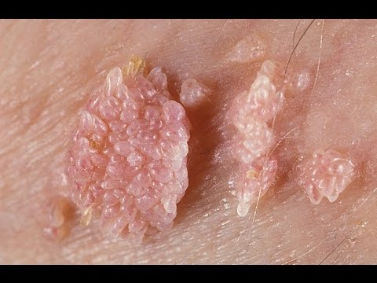
HPV
Virus (not curable)
Vaccine - helps with the most “popular” strain
Symptoms:
May have no signs or Symptoms
Genital warts
Itching around warts
Bleeding in affected area
Cancer (Long Term)
HPV is so common that most sexually-active men and women will get at least one type of HPV at some point in their lives.
79 Million people are infected with this disease

Slide 9
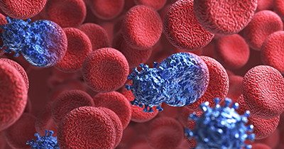
HIV / AIDS
Stage 1: Acute HIV infection
Within 2-4 weeks experience flu- like symptoms
Often unaware have the virus
Stage 2: Chronic HIV infection
May have no symptoms or get sick
This period can last a decade or longer
Stage 3: AIDs
Badly damaged Immune Systems
increased number of Illnesses
- Symptoms: chills, fever, sweats, swollen lymph glands, weakness, and weight loss
Can survive about 3 years
Magic Johnson has been in this stage for over 23 years
Can be treated with medication to prolong life.
Cost ~ $2,000-5,000 per month

Slide 10
Genital Herpes
Frequency & severity of breakouts vary
HSV-1:
NOT an STD
50% of population has this
Cold Sores on mouth
Typically spread through kissing, sharing cups, chapstick, etc.
HSV-2:
STD- anal, oral, vaginal
Sores
Virus is in fluid of sore
Fluid spreads the STD
Looks like blisters on & around genitals
Virus- cannot be cured, but outbreaks can be managed with medication
Can be passed to child during birth
Signs / Symptoms are more common in women than men
87% of infected people are unaware they have herpes

Slide 11
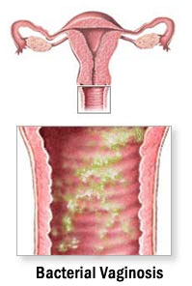
Bacterial Vaginosis
What is it: too much of a certain bacteria in the vagina
*Typically occurs in sexually active women
Signs/ Symptoms:
A thin white or gray vaginal discharge;
Pain, itching, or burning in the vagina;
A strong fish-like odor, especially after sex;
Burning when urinating;
Itching around the outside of the vagina.

Slide 12
How to AVOID STDs
Abstinence (no sexual activity until marriage)
Proper use of a latex condom
Communication with your partner
Fewer sexual partners
You and partner get tested before sexual contact

Slide 13
Places you can get Help
Scott County Health Department
School Nurse
Guidance Counselor
Health Teacher

