Slide 1
Today we will:
Identify types of abusive relationships
So we can:
know the warning signs & be able to help a friend in need

Slide 2
4 types of abuse:
Physical Abuse
Sexual Abuse
Emotional Abuse
Neglect (physical and emotional)
Notes:
Give examples from each

Slide 3
Example:
You are riding your bike past your neighbors house and notice they are visibly upset so you stop by. You notice bruises on her arm so you ask her what happened. She immediately makes up a story that seems weird. In the past, she has shared with you that her boyfriend tries to control her by telling her what to do and who to hang out with. She also says he won’t let her do things she wants to.

Slide 4
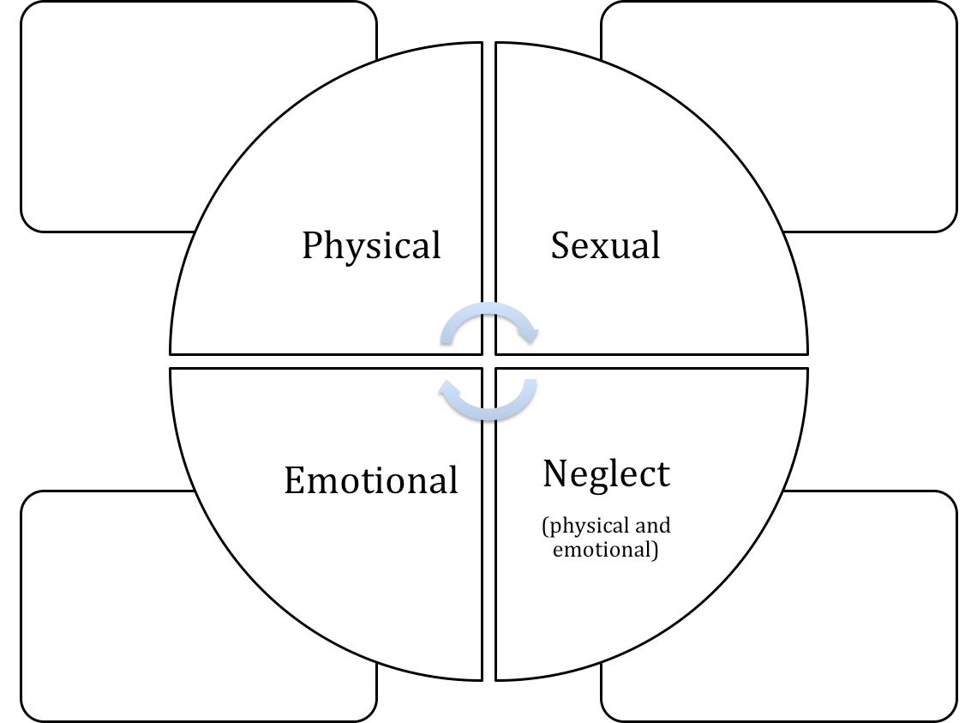
Bruises
Makes up lies about marks on the body
Partner is Controlling

Slide 5
Scenario 1:
Sam and Taylor are two 8th graders who started ‘talking’ but are not officially in a relationship. Everyone thinks they should be together. Sam doesn’t like when Taylor wears red or blue clothing. Taylor’s favorite color is blue. Sam thinks Taylor should stop wearing red and blue because it makes Taylor look ridiculous and draws attention. Taylor’s mom just gave Taylor a brand new, really cool Nike jacket. It’s blue. Taylor doesn’t want to wear it, but doesn’t want to hurt Mom’s feelings.
Notes:
Emotional

Slide 6
Scenario #2
You and a friend live on the same wing in the dorms. You walk by her room and hear her crying. In the past, she has shared with you that her boyfriend yells at her, humiliates her, and always wants to know where she is and who she’s with. She also says he won’t let her do things she wants to.
It appears she has some fresh bruises around her eye and on her arms.

Slide 7
Scenario 3:
Devin and Chris like each other and have been flirting a lot lately. Chris and Randi just broke up and Devin has been snap chatting Chris all day every day. Devin got grounded and could not go to the high school football game, so Devin asked friends to spy on Chris. Devin’s friends sent Devin snap chats and videos of who Chris was sitting with and talking to. The friends followed Chris around and even told Devin what Chris ordered at the concession stand. Devin started and argument with Chris via text because of who Chris talked to in line at the concession stand. Chris was talking to Randi who was waiting for food one line over.
Notes:
Emotional

Slide 8
Scenario 4:
Jem and Gene are sophomores in high school. Jem and Gene are two of the high schools most popular kids and are the best athletes and involved in lots of activities. They were both voted to be on homecoming court. Jem and Gene do everything together. Jem started acting weird at school and Jem’s grades started slipping. Gene has been acting normal, keeping great grades, and making classmates and teachers laugh, and made the game winning shot Friday night. Jem sat with Gene and friends at lunch after missing two days of school. Jem’s friends noticed a few small bruises on Jem’s wrist. Jem and Gene have been spending all of their free time together, but Jem seems distant.
Notes:
Physical

Slide 9
Scenario 5:
Blair and her parents have had a great relationship. They have family dinners and they trust Blair to take care of her siblings when her parents are out. Lately Blair’s parents have been going out more frequently and have been leaving Blair to take care of her two younger siblings. The siblings are 3 and 7, Blair is 14. Her parents used to leave frozen food, like chicken nuggets and pizza, for dinner. Blair’s parents are out for the 4th time this week and Blair is struggling to get her homework done. Last night Blair used the last frozen pizza and there is not much else to make in the house. Blair and her 7 year old sibling are also out of lunch money at school, and have not been able to turn in the permission slip for the class field trip.
Notes:
Neglect

Slide 10
Scenario 6:
While you are home alone, you invite a friend over to your house to help you with your homework. After doing homework they try to kiss you. You try to push them away because you feel things have gone too far. They say, “Come on you didn’t just invite me over here to do homework.” You want to get out of the situation and make sure it doesn’t happen again. Your friend puts their hand on your leg and says, “last time we had so much fun!” Your friend starts touching you and you don’t stop it.
Notes:
Sexual

Slide 11
Scenario 7:
You’re in a group chat with several people in your grade. Someone took a screenshot of a snapchat Shelly sent to them. Shelly is only wearing underwear and a bra and is posing in her bathroom mirror. The people in the group chat start laughing at the picture and making fun of the girl. The next day at school, another girl, Sal, in the group chat started following her and taking pictures of her butt in the hallway. Sal sent the pictures to the group where everyone started talking about her again. You get called to the office later that day, and everyone in the group chat is there. Someone ratted you out and turned in the pictures.
Notes:
Sexual

Slide 12
Scenario 8:
You and your significant other have been dating a few months now. You are both involved in sports after school and you are both in band, so you have a lot in common. You do a lot together and you get along great. Your friends like your partner, your family likes your partner. Lately, your partner has only been talking about their sport and their big tournaments on the weekends. Whenever you bring up your sport they start talking about themself. They rarely ask how you are doing or what’s going on with your life. At the last band concert they didn’t even notice you had a solo until the night of the concert. It’s almost like you aren’t even there.
Notes:
Neglect

Slide 13
Scenario #9
Audrey has had trouble recently focusing in class and has turned in a couple of assignments late, which is unlike her. You know her parents are going through a divorce and that she’s spending time at both homes. You ask Audrey how things are going, and she says she is getting really tired of her parents bad-mouthing each other and pressuring her to choose one parent over the other. She’s sick of hearing it, wishes they would stop, and sometimes wants to just scream. When you ask, she says she stays with her Aunt Ginny when she needs a break. She can talk to her Aunt Ginny. Audrey is unhappy but seems to be coping, and although her work isn't at its usual level, she is doing OK in school. But it isn’t fair she has to deal with this.

Slide 14
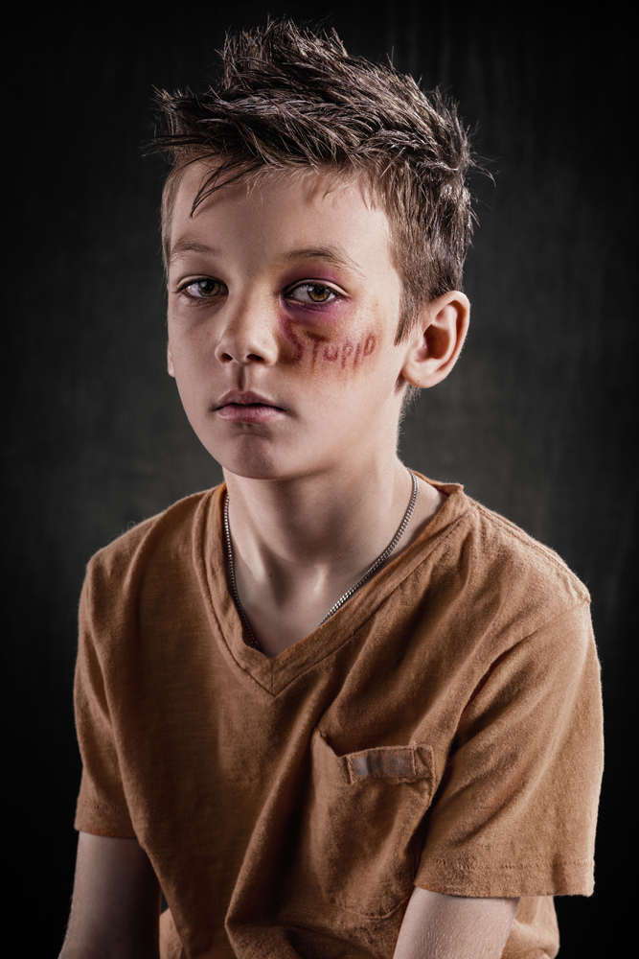
Physical Abuse

Slide 15
Sexual Abuse
behavior

Slide 16
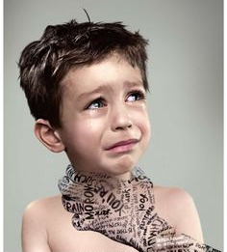
Emotional Abuse

Slide 17
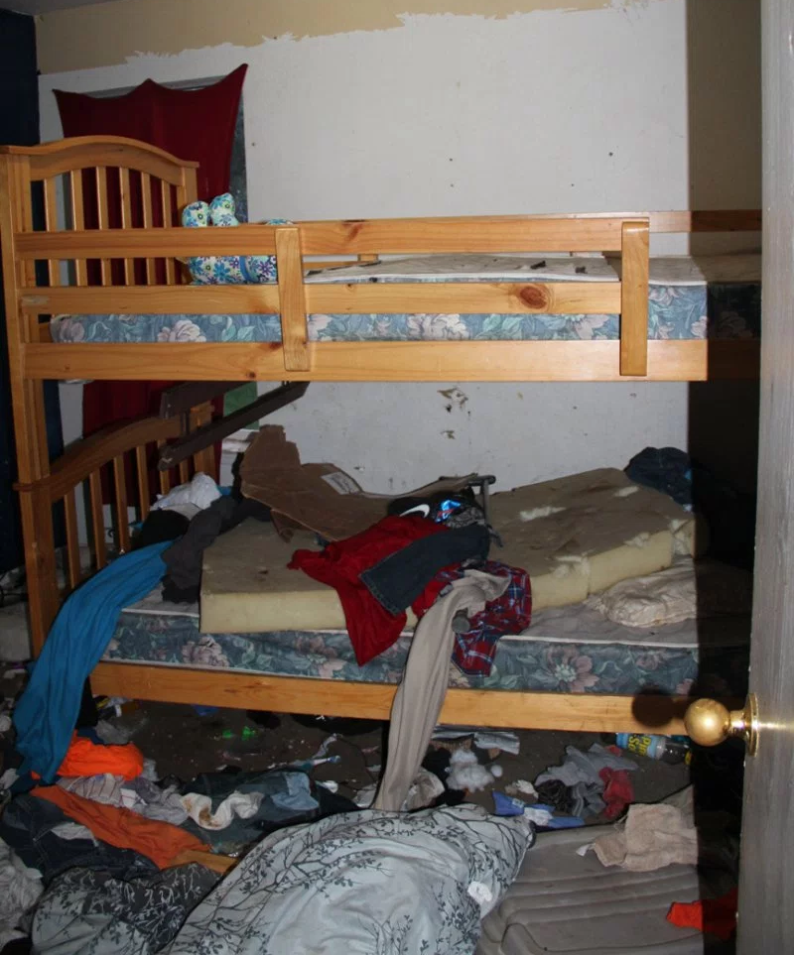
Neglect

Slide 19
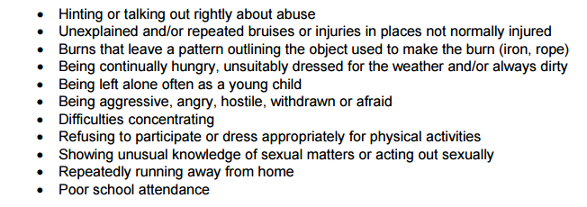
Other signs someone's in a abusive relationship

Slide 20
If you notice a friend
in an abusive relationship…. You can:
Talk to them
Tell them you are concerned about their behavior
Tell them abusive behavior is not okay
If the situation is violent, or someone may become seriously hurt, call 911 immediately

Slide 21
If you notice a friend being abusive
in a relationship…. You can:
Encourage them to own up to their behavior
Explain that controlling, obsessive, jealous behavior is not love and does not represent love.

Slide 22
If you notice a friend in an abusive relationship…. You can:
Tell.
Recommend they seek help from a trusted adult
Parent, Counselor, School Admin, Teacher, Coach
YOU should also tell a trusted adult
Violent / abusive behavior cannot be tolerated.

