Slide 1
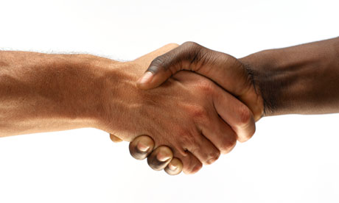
Handy Hints for shaking hands

Slide 3
6 Ways to the Perfect Handshake
With dry, soft palms
With a firm, but not too crushing, grip
With your hand approaching from the side, not above as this seems too dominating
For one- two pumps
With eye contact and a smile
With appropriate follow-up conversation

Slide 4
Introductions
Always walk confidently towards the interviewer
Extend your hand and introduce yourself
Repeat their name if possible!
Stop shaking hands when you are done with the introduction and have a seat
*Always stand up to shake hands*
PRACTICE

Slide 5
Dress For Success!
What TO Wear:
Dress Pants
Nice Shirt or Polo
Dress Shoes
Neutral Make-Up and Simple Accessories
What NOT to Wear:
Sweatpants
Messy Hair
Mismatched Clothes
Distracting Makeup or Jewelry
Hats
Notes:
This would be appropriate for your first “big girl or big boy” job interview - if you were to interview for a part time position, nicer pants and shirt would be appropriate. No need for a suit to interview for Fareway! But look professional and clean - don't make them question your outfit!

Slide 6
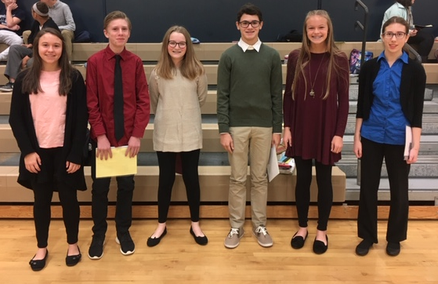
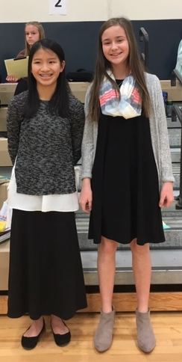

Slide 7
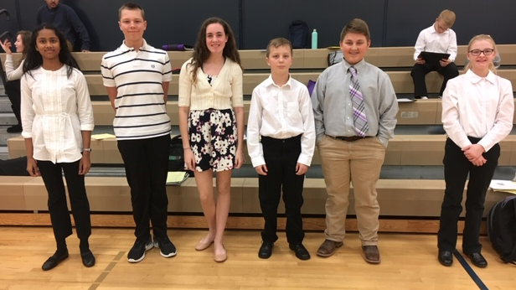
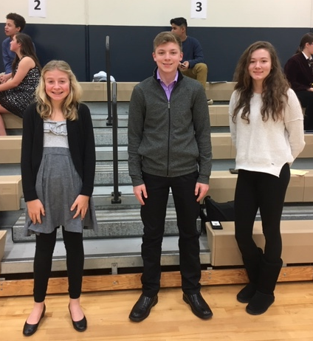

Slide 8
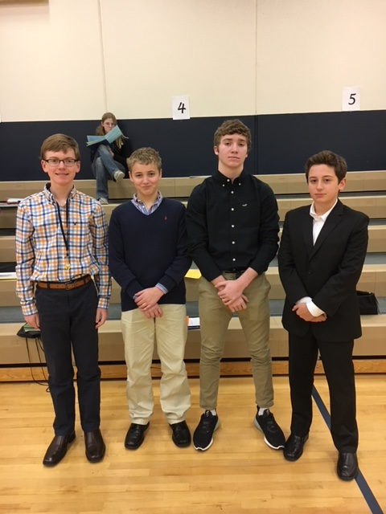
Remember:
Be Professional
Only have 7 seconds to make a good 1st impression

