Slide 1
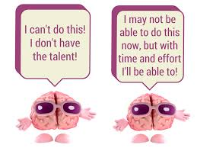
Today we: will learn what a growth mindset is
So we can: begin to develop our own growth mindset

Slide 2
Review Game

Slide 3
What Mindset are you??
Fixed Mindset
students believe their basic abilities, their intelligence, their talents, are just fixed traits.
Avoid challenges
Give up easily
See effort as dumb
Ignore useful criticism as negative feedback
Feel threatened by the success of others
Growth Mindset
students understand that their talents and abilities can be developed through effort, good teaching and persistence.
Embrace challenges
Persist in the face of setbacks
See effort as the path to mastery
Learn from criticism
Find lessons and inspiration in others success

Slide 4
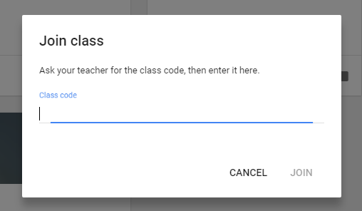
Google Classroom
1st Hour:in3g4ki
3rd Hour:hn9ci2
4th Hour:v00npv1
5th Hour:5ylgi3h
6th Hour:5sgws5t
7th Hour:2bus2u
2.Type in Class Code then push join

Slide 5
Google Classroom-- Schoville
3rd Hour:
mtp4u2
7th Hour:
ndqjiep
2.Type in Class Code then push join

Slide 6
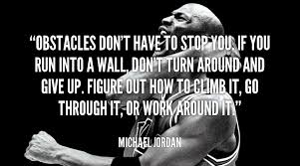
Individually
Come up with 2 or more Growth Mindset
Statements for each Fixed Statement
Example: I made a mistake | I should practice this so I won’t make this mistake again.

