Slide 1
Type into Google Search:
Google Tour Creator
Click “Get Started”
Click “ + New Tour” (top left)

Slide 2
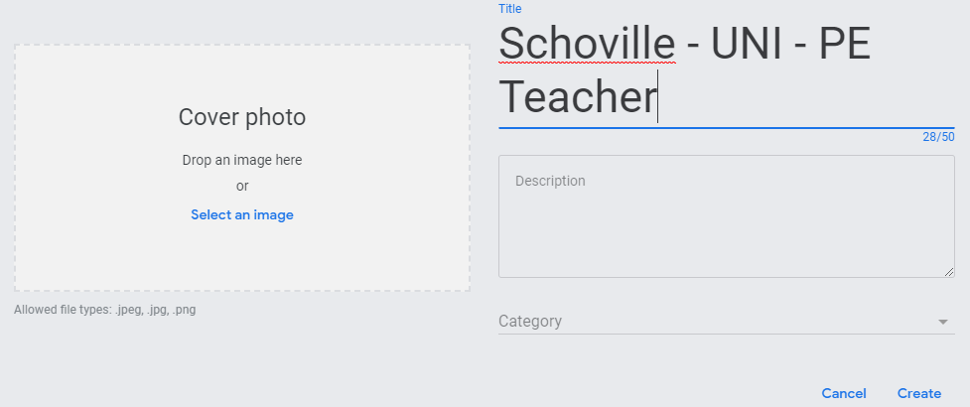
Title: Last name - College - Career
Insert your college logo for your cover photo

Slide 3
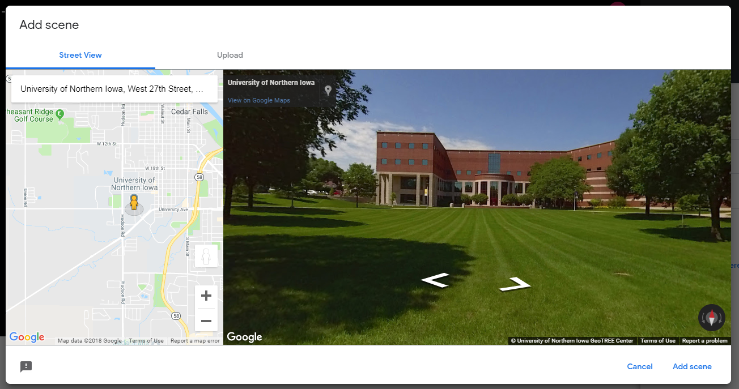
Click “Add Scene”
Type into the google search the name OR location of your college

Slide 4
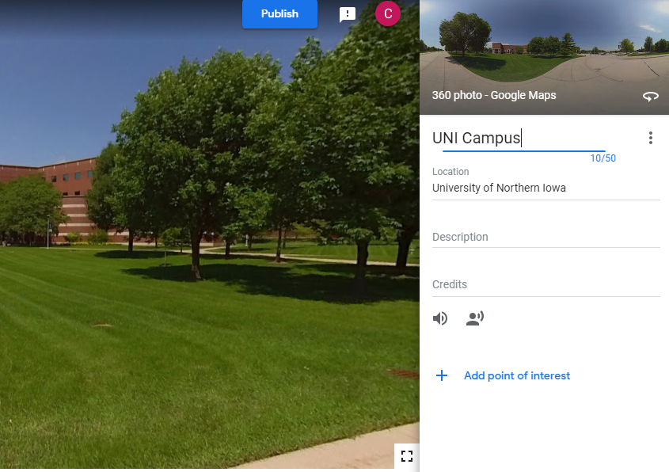
Name Your Scene
2. Add Point of Interest

Slide 5
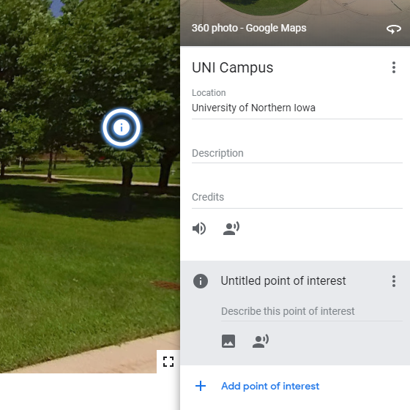
Name Point of Interest:
Type
Location
Student Population
Entrance Difficulty
Tuition
Majors
2. Type your description here (using info from your research)
3. Add an image here relating to your description

Slide 6
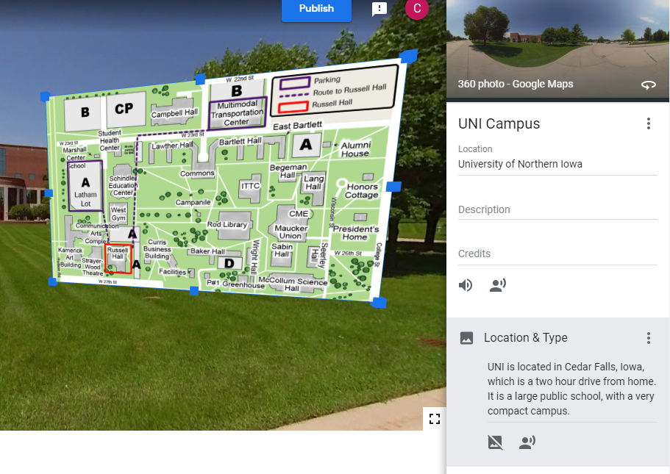
Repeat the previous steps to create a scene for your Career
This is an example of what yours will look like:
Name of Point of Interest
Description (in detail)
Image supporting description
3
1.
2

Slide 7
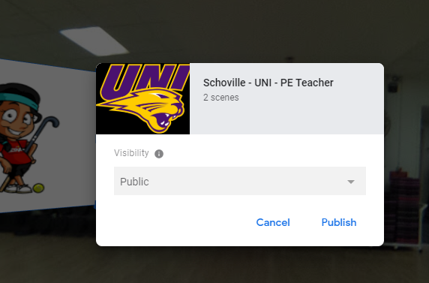
When you think you are done:
Click “PUBLISH” (top right)
Click Publish again.

Slide 8
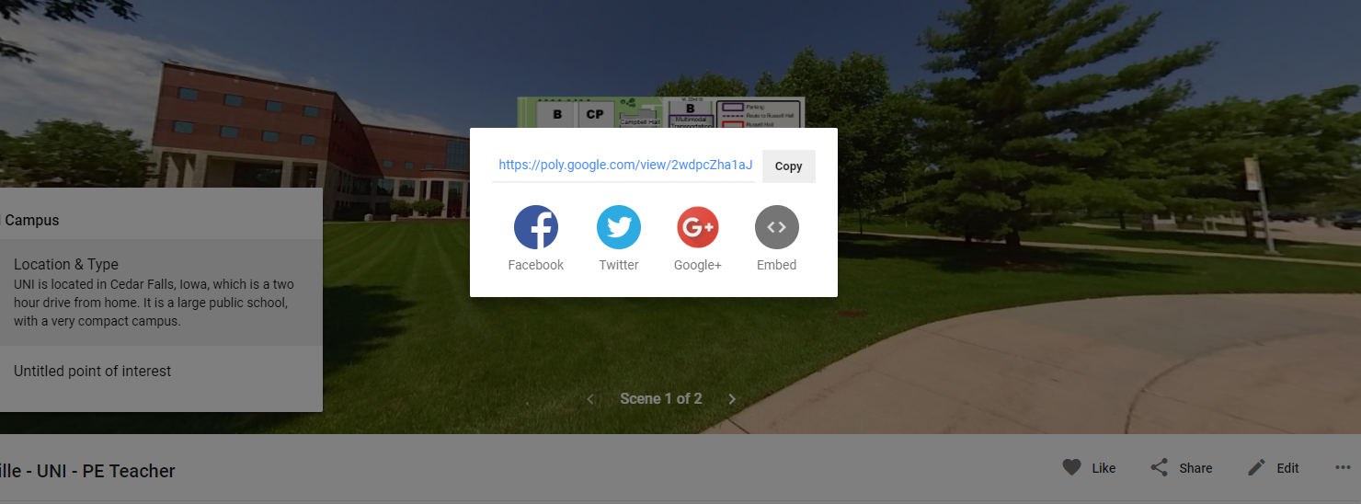
Select View Tour.
Select SHARE
COPY LINK --- paste link into final rubric

