Slide 1
Comparing Colleges
Today I will: Compare the characteristics of 3 colleges
So I can: Determine the best college fit for me

Slide 2
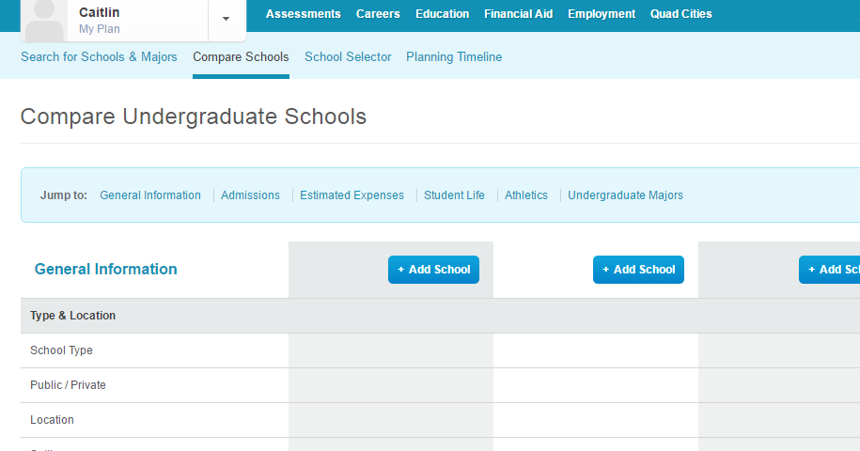
College Comparison Worksheet
1
Click on Education
Click on Compare Schools
Undergraduate Schools
Click on “Add School” Add:
Iowa School
Out of State
Optional
Complete Worksheet
(Due at the end of the class period)
2
3

Slide 3
College Comparison Example
UNI
Michigan State
Iowa
Public- University
Cedar Falls
Public- University
East Lansing, MI
Public- University
Iowa City
I choose UNI because Cedar Falls is only 3 hours away from home which is still close for me to visit my family
I choose Michigan State because…….
11,928
50,085
31,387

