Slide 1
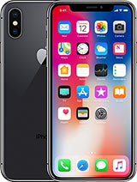
Primary expense
Secondary expense
Primary expenses are high-priority necessities that are generally paid first.
Examples??
lower-priority goods and services that you want but could live without
Examples??
Notes:
What is a primary expense and secondary
Examples for each category
Now that you have your expenses in the right order it’s time to make budget guidelines…. Why is it important to set guidelines for each category?

Slide 2
Expense Examples
Primary Expense:
Mortgage/ Rent
Utility Bills (water, heating, electricity)
Transportation
Food
Savings (pay yourself 1st)
Insurance (Health/Car)
Cell Phone**
Secondary Expense:
Education
Entertainment
Restaurants
Sports/Extracurriculars
Cell Phone**

Slide 3
Why is it important to set budget guidelines for each month’s expenses?
Able to manage your money effectively
Monitor spending (don’t overspend in certain areas)
Plan for the Future
Identify spending problems
Improve decision making

Slide 4
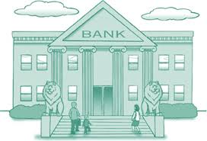
What are 2 accounts you can open at a bank?

Slide 5
Definitions
Interest: amount added to your total
** can be a good thing or a bad thing**
Savings Account
A bank account that earns interest
**allows you to accumulate interest on funds you’ve saved for future needs **
Average interest rate on a savings account
is from 1%- 6%.
Checking Account
account held at a financial institution that allows for withdrawals and deposits.
** offers easy access to your money for your daily transactional needs and helps keep your cash secure **
Interest rate: percentage added to your total

Slide 6
Definitions
Debit
the amount deducted from your bank account
*When you spend money, that is a debit towards your account
Credit( Deposit)
adding an amount to your account
*When you put money into your account (paycheck), that is a credit towards your account

Slide 7
What ways can money come out of your checking account? (think spending)

Slide 8
How does it work?
Debit Card
The card owner deposits money into a bank account. The card can be used to withdraw this money or to purchase goods and services.
Buy Now, Pay Now
Credit Cards
Each time the card owner purchases goods or services with the card, he or she is borrowing money from the credit card company.
Buy Now, Pay Later

Slide 9
Are there any limitations on how much you can spend?
Debit Card
You CANNOT spend more than what is in your bank account.
If you spend more than the balance of your account, you will owe the financial institution this money plus a hefty fee.
Credit Cards
You will be given a credit limit. This is the maximum dollar amount you can borrow.

