Slide 1
Variables to Consider
Majors
Location
Tuition
Scholarships
Athletics
Population
Class size
Admission requirements
Greek Life
Clubs
Housing
Financial Aid
Graduation Rate

Slide 2
Saving to My Plan
Save 3 Careers to MY Plan
2 Career Clusters
User: ID #
PW: Dw010800 (Initials + Bday)

Slide 3
Saving Careers to “My Plan”
→ assessments → 09/18/18 → Click on a career of interest
Blue “Save to My Plan” (Top right corner)
Save 3 careers to Your Plan

Slide 4
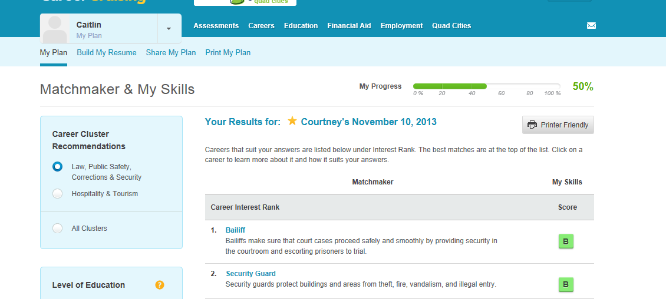
Saving Career Clusters
→ Assessments → 09/18/18
Save “Career Clusters” to My Plan
2. Click here

Slide 5
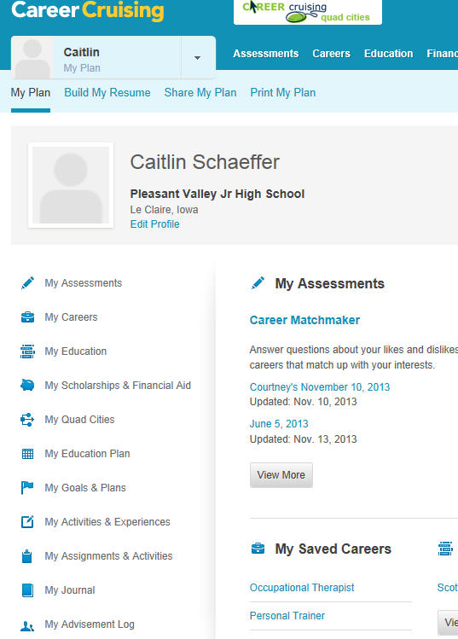
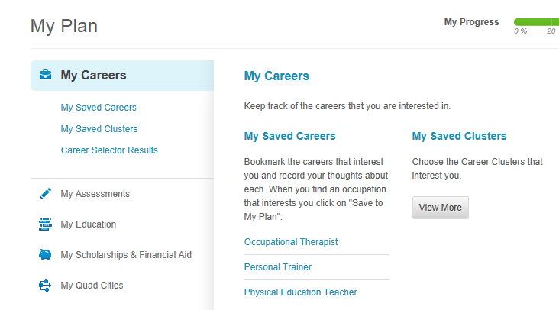
3. Click My Careers
4. Click My Saved Clusters

Slide 6
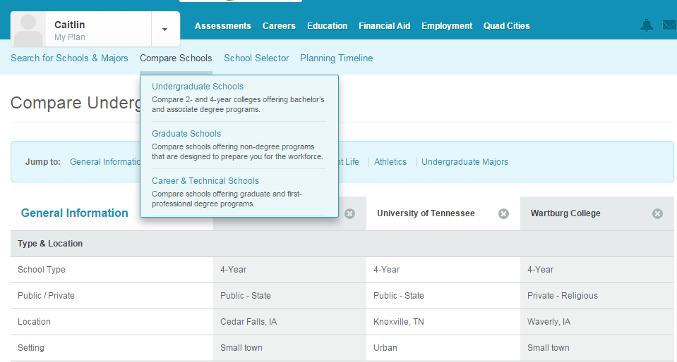
Comparing Colleges
Click on Education
Click on School Selector
Undergraduate Schools

Slide 7
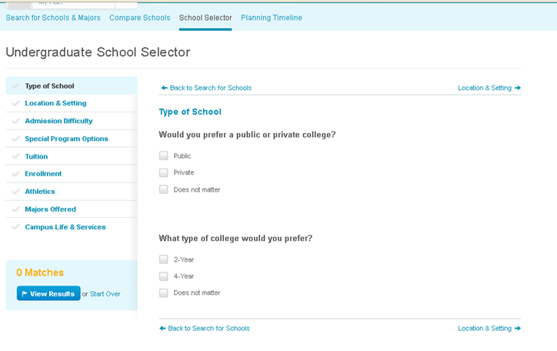

Slide 8
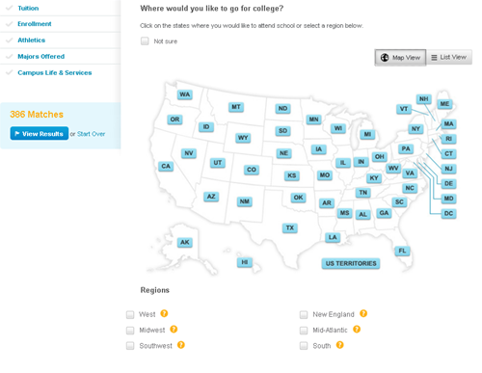
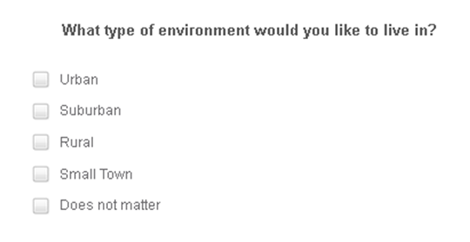
Choose by a SPECIFIC STATE or STATES
or REGION/GROUP of STATES
Urban: Bigger Cities/More People
Suburban: Residential Area surrounding a City
Rural: Less People/Spread Out (farm area)
Small Town: Smaller Community with less people

Slide 9
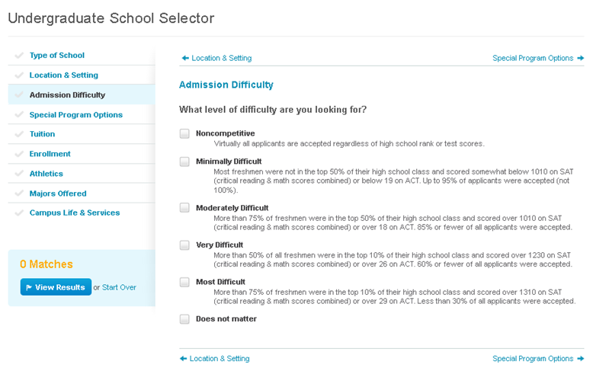

Slide 10
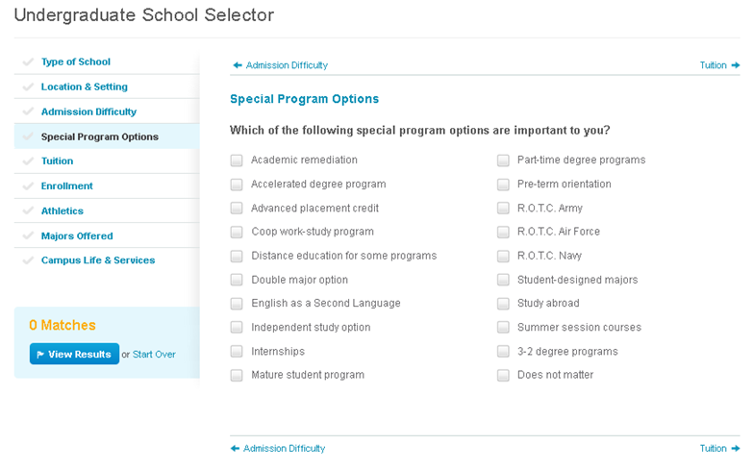
Skip this

Slide 11
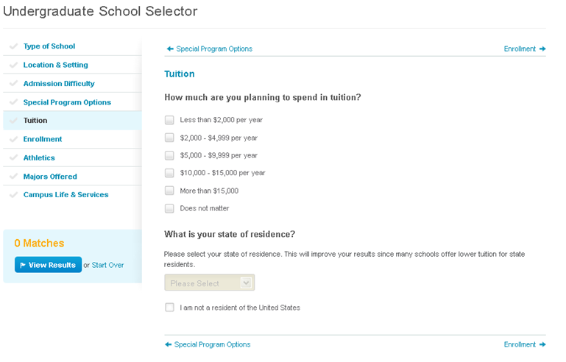
May choose more than one
IOWA :)

Slide 12
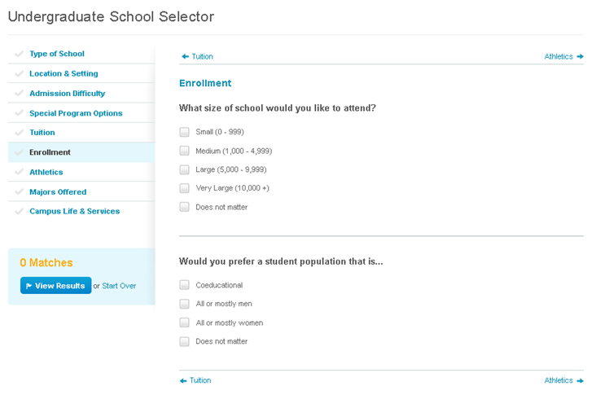

Slide 13
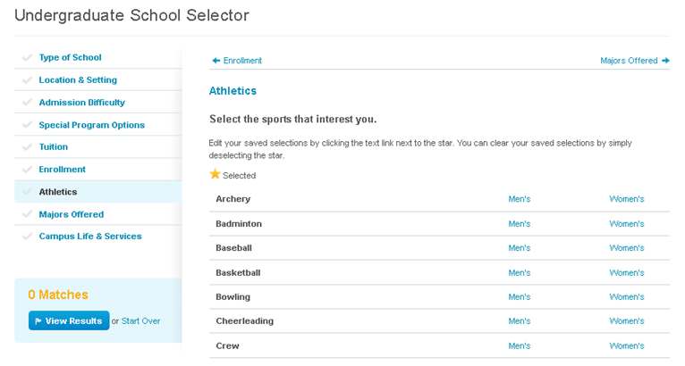
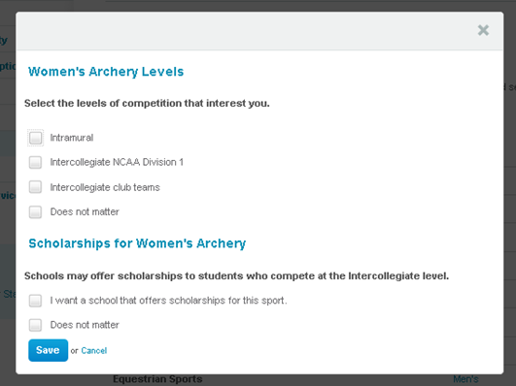
Click on the men’s/women’s Sport you want
Division 1 = top athletes in the COUNTRY!!!

Slide 14
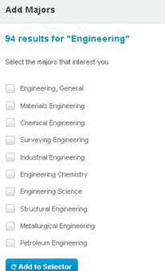
If you know what major you want to focus on click here
Type in your major or program
Check the major or program and click ADD TO SELECTOR

Slide 15
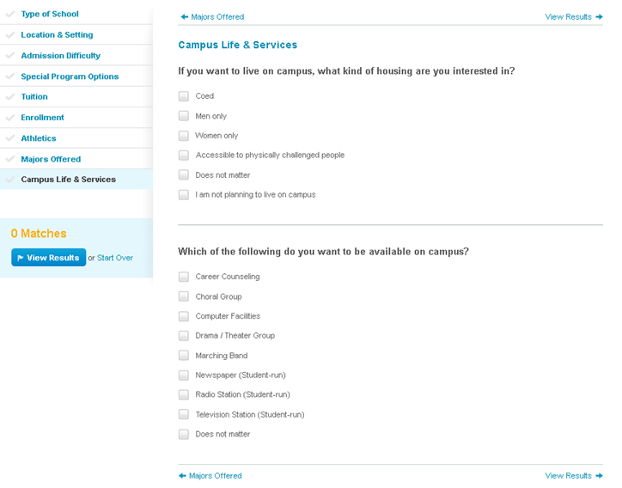
Do not choose the last option!
Check the options you are interested in!

Slide 16
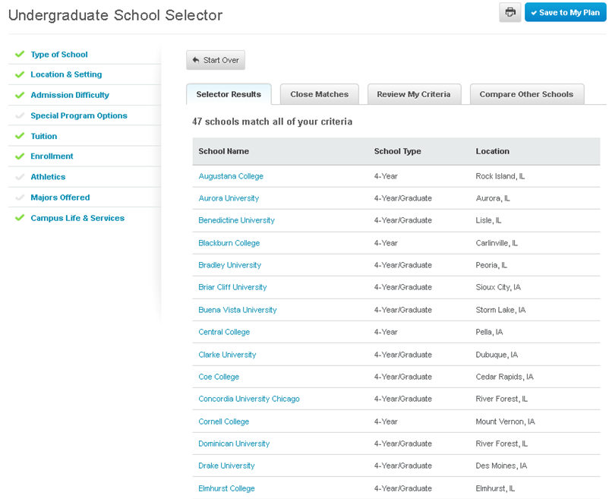
Explore the colleges on your results page and Save your top 3 choices to “Save My Plan”

