Slide 1
Financial Report
Today we will:figure out our Net monthly income
So we can: develop our budget

Slide 2
Class Reflection
1. Average High School Graduate Earns: _______________________
a. Monthly Amount: _______________________
b. Amount of Set Back: ___________________________
What will be your Expense Priorities?
What will be your Monthly Goals?
What surprised you from your total?
What do you want to know more about?

Slide 3
Definitions
Gross Annual Income:
(GAI)
How much you make each year BEFORE taxes
Gross Monthly Income:
(GMI)
How much you make each month BEFORE taxes
Net Monthly Income:
(NMI)
How much you make each MONTH after taxes
Get it? Net. haha!

Slide 4
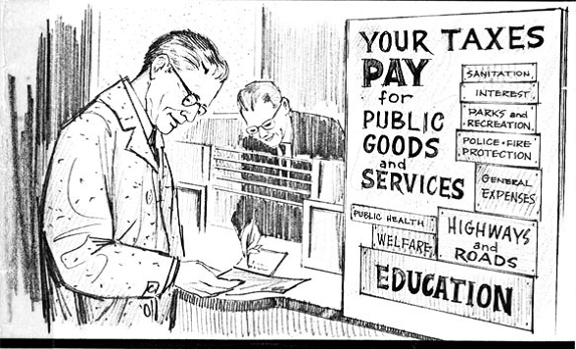
What taxes are taken out of your paycheck?

Slide 5
Definitions
Federal Income Tax
A portion of one’s personal income paid to the government
**The more you make, the more you pay**
Income tax pays for:
Social Security, Medicare, Retirement programs, Military, veterans, Interest payments on national debt, Social programs- medicaid, food stamps, unemployment, Law enforcement- prisons, FBI, CIA
Social Security
- A federal insurance program that provides benefits to retired persons, the disabled, and spouses of deceased workers.
- Provides economic security for Americans unable to work.
- Comes from workers and employers
Medicare
The federal health insurance program for people who are 65 or older or certain younger people with disabilities.

Slide 6
To Do:
Session 1:
Complete Budget Guidelines
Complete Extras
Homework:
Session #1

Slide 7
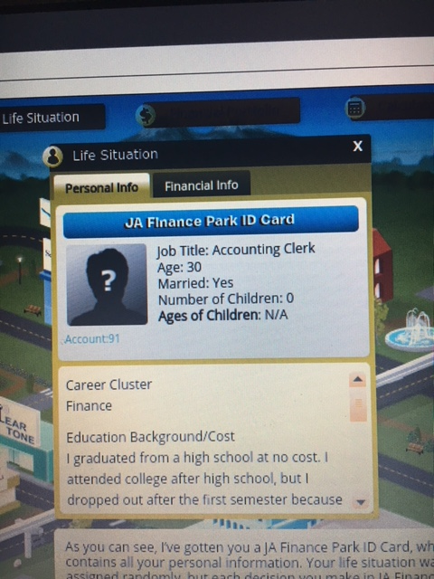
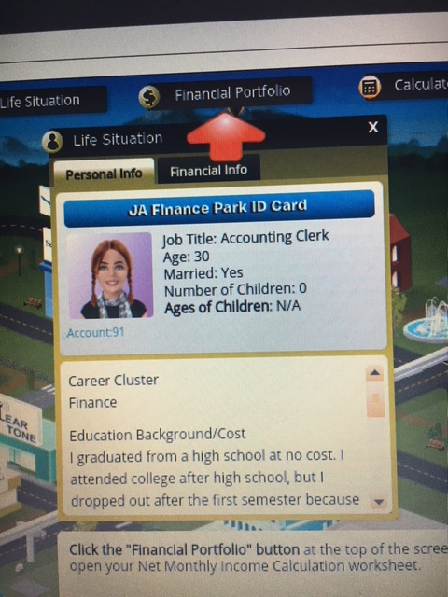

Slide 8
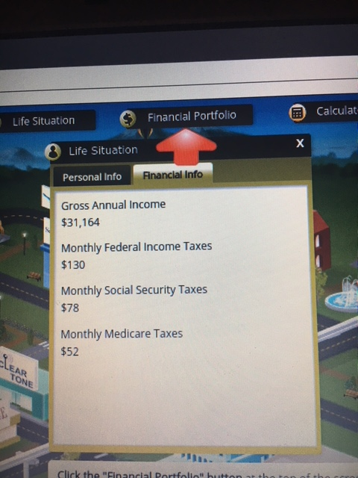

Slide 9
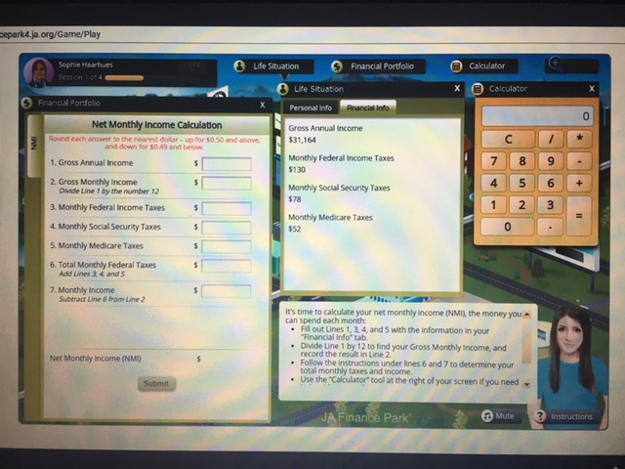

Slide 10
