Slide 1
Log into Career Cruising
Grab the gold sheet from last time
User: ID #
PW: Dw010800 (Initials + Bday)
Click on Assessments →Click on 9/18/18
3. Pick out any 1 career of your 40 choices and write it on the oval your gold sheet
(cannot be professional athlete, model,
actor, singer, dancer, or bartender)

Slide 2
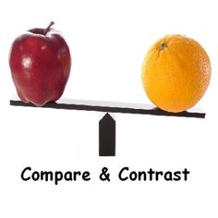
Today I will: compare two careers of interest
So I can: determine that best career fit for me

Slide 3
Career Comparison Chart
After selecting your #1 Career Choice, fill out the top half of the Career Comparison Chart.
Below are guiding questions to help you fill out your Career Comparison Chart by using the tabs on the left hand side of the webpage:
Job Description
What does a person in this career do?
Education
What education level will you need? How many years?
What type of college has this program?
Which high school classes do I need to focus on?
Earnings
What is the annual range for salary in Iowa?
What is the outlook for this career?
How many annual average openings?
At a Glance
List the Attributes and Abilities you need to be successful in this career (4 or more)

Slide 4
Careercruising.com
1. Take the “My Skills” test
Click → Assessments
Click → Start My Skills (in small blue writing)
*Read each statement thoroughly before choosing your skill level -- the smaller print gives more details as to what the skill means

