Slide 1
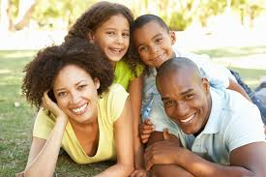
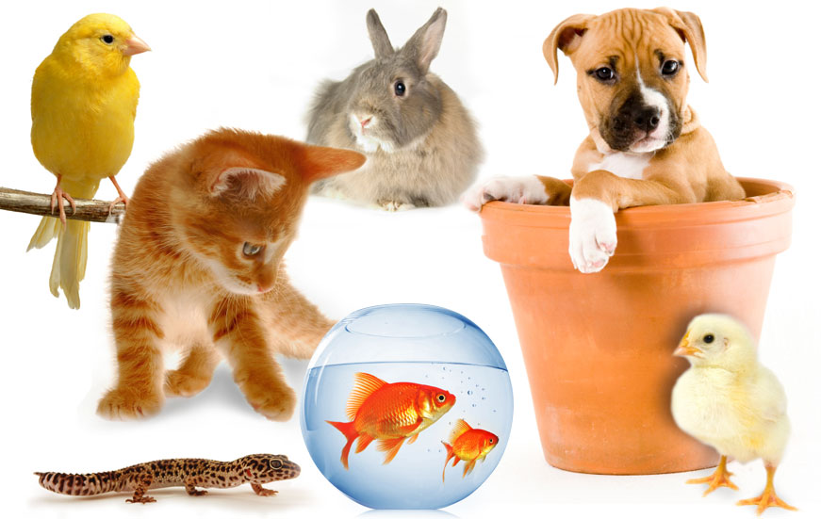
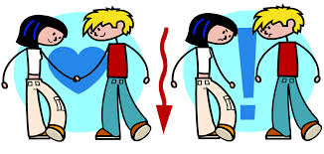
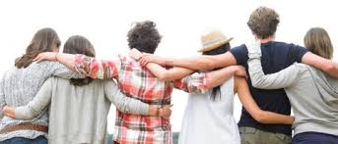
Today we will: analyze characteristics of relationships
So we can: develop our own healthy relationships

Slide 2
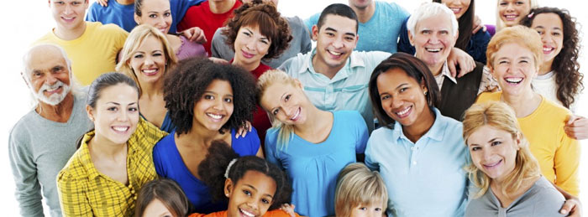
What is a relationship?
Notes:
Asks students their definitions of a relationship.

Slide 3
Relationship:
2 or more people that are connected in a way & behave in a certain manner
What are the different types of relationships?

Slide 4
Types of Relationships:

Slide 5
Healthy vs. unhealthy
Notes:
Individually brainstorm characteristics of healthy vs. unhealthy
Then assign tables to one of the 2 and have them write on white paper
How do you decide if a relationship is a healthy one or not

