Slide 1
Today we will: Explore career cruising website
So we can: view potential careers of interests

Slide 2
Log into Career Cruising
www.careercruising.com
How to Log In…..
Username: studentID#
Password: initials + birthday (mm/dd/yr)
EXAMPLE: John Smith January 22, 2005
PW: JS012205

Slide 3
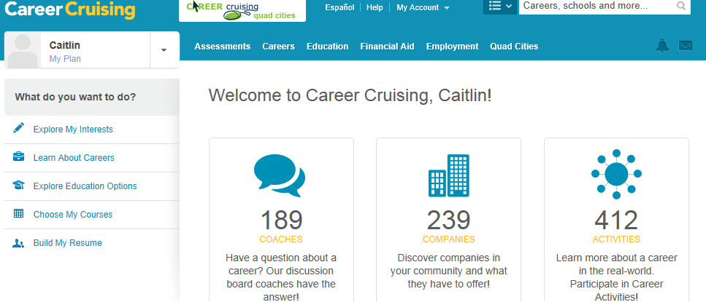
Time to Explore
Explore the QC. What they do, job opportunities. Search Industries- find one that interests you.
Explore careers based on favorite subjects, clusters or keywords.
Explore Companies in the QC. What they do, job opportunities. Search industries- find one that interests you.

