Slide 1
What is a Cover Letter?
To provide detailed information on why you are qualified for the job you are applying for.
**Effective cover letters explain the reasons for your interest in the specific organization and identify your most relevant skills or experiences.**

Slide 2
What is the purpose of a Cover Letter?
Introduces yourself to an organization, demonstrates your interest in the company or a specific vacancy, draws attention to your resume and motivates the reader to interview you.

Slide 3
The heading of a cover letter looks like this:
Jane Doe
1245 School Lane
Oxford, Iowa 51122
(563) 555-5123
DoeJane@gmail.com
Yours looks like:
Name: ________________________________
Address:______________________________
City, State, Zip:__________________________
Phone:_______________________________
Email: ________________________________

Slide 4
Who do I address the Cover Letter to?
Research the company’s website for the person in charge of the department you are applying to, or a person in Human Resources.
Example: Managers
What information do I include?
Dear Mr. / Ms. First Last Name or Dear Mr. / Ms. Last Name
Example: Dear Mr. Jason Vice OR Dear Mr. Vice

Slide 5
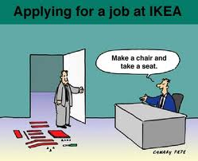
What information should be included in the first paragraph?
WHAT: is the job you want?
(Ex: STOCKER)
WHERE: did you see this job
posting? (Ex: QUAD CITY TIMES!)
WHY: you are the BEST person
for this job?

Slide 6
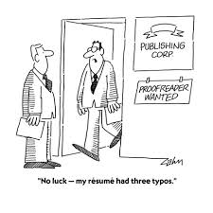
What information should be included in the second & third paragraph?
(second) Past work experience and skills obtained
(third) SHOW academic achievements and skills
To show this, use:
-Characteristics shown
in school (honest)
-Honors, awards or leadership positions

Slide 7
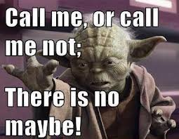
What information should be included in the last paragraph?
Request an interview
Use:
Contact information

Slide 8
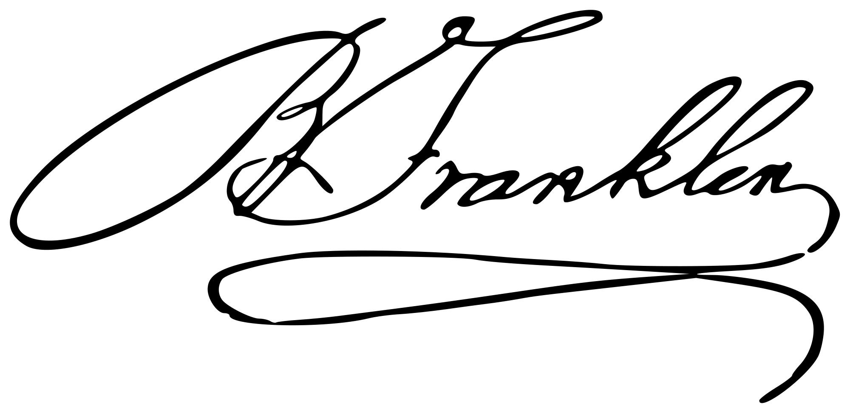
How do you end a professional cover letter?
Sincerely,
Your Name Typed / Printed
This is where you sign your name

